Slide 1

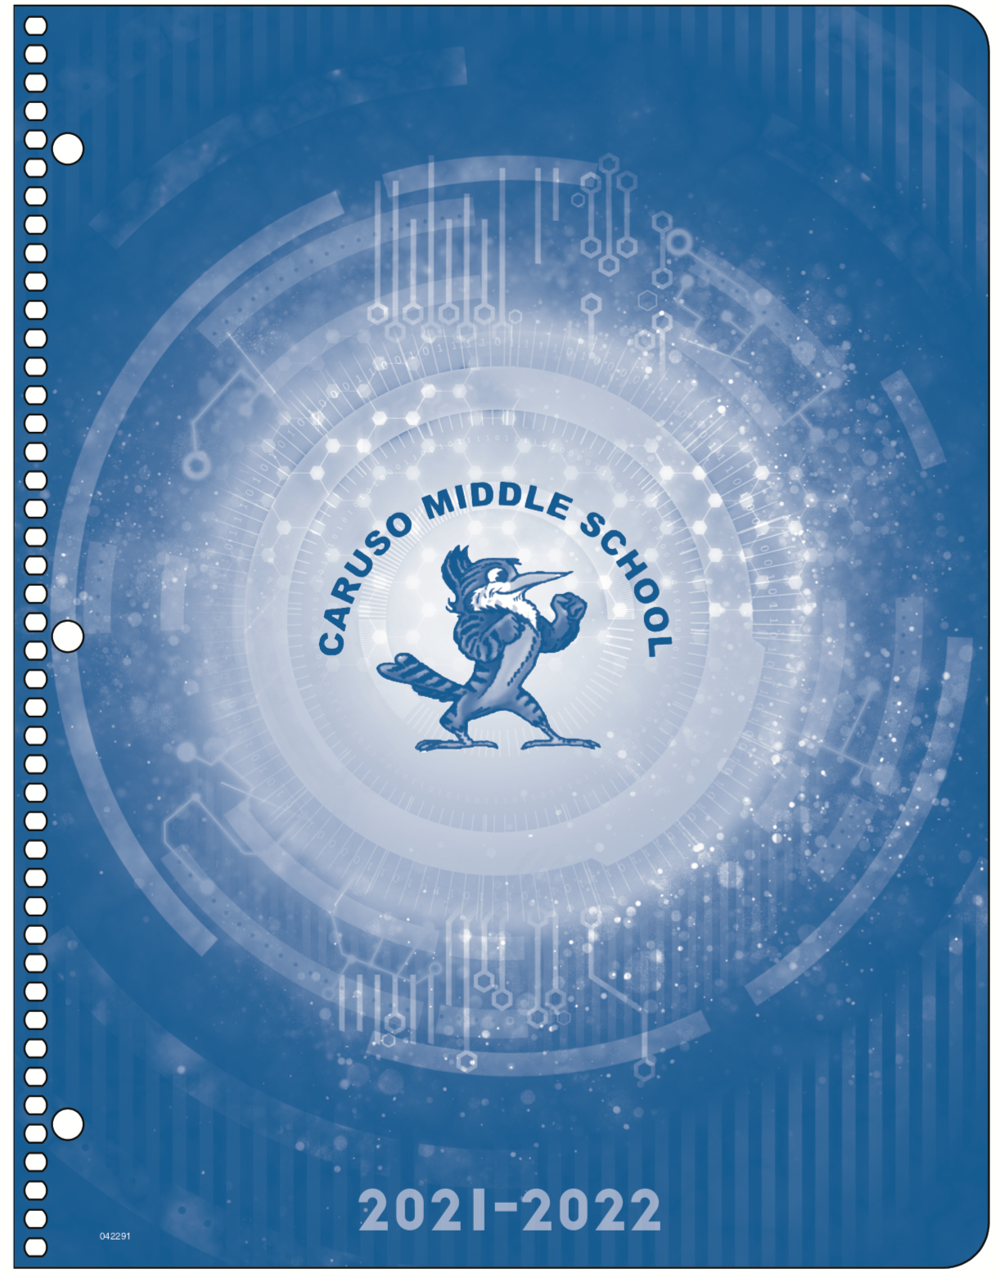
Order at
DeerfieldCoalition.com
by
June 1st
School Supplies Lists
2021-2022
Calculators are required for all students:
TI-108 calculator for 6th grade general math
TI-30XA calculator for Grade 6 Geometry Pathway and all 7th & 8th grade math
If you purchase supplies on your own, you can get the following required items online:
Caruso Assignment Notebook
Calculators
STEM Memory Card
Art Sketch Book
Science Goggles
Glow Index Cards
Headphones & Earbuds

